Slide 1
Febrile Seizures in Pediatrics
By Natalie Johnson, PA-S

Slide 2
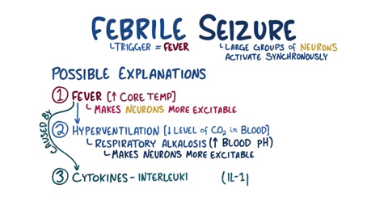
Why can fevers cause seizures?

Slide 3
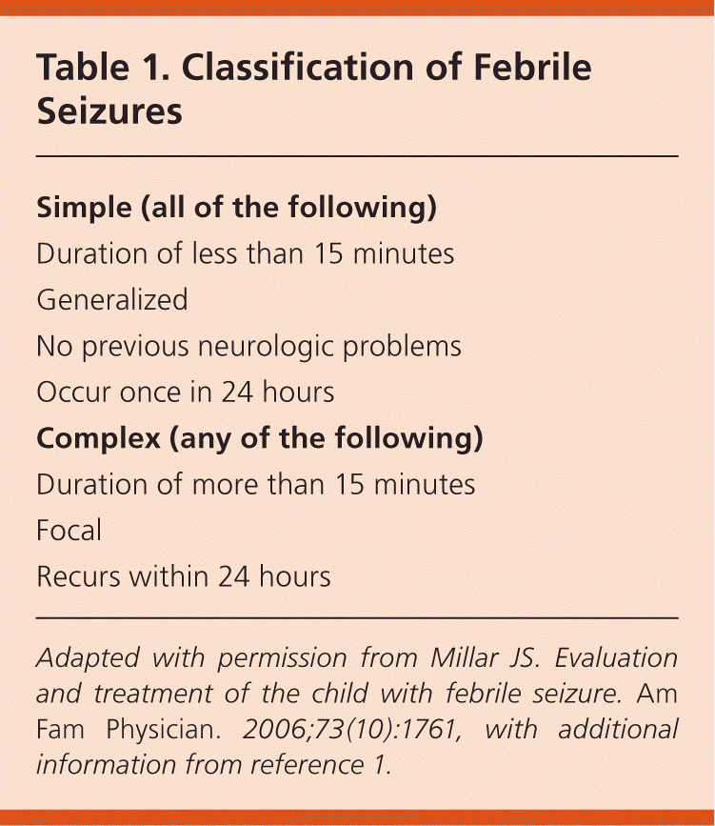
What are the classifications?

Slide 5
Common causes and risk factors
The cause of febrile seizures is likely multifactorial
Viral illnesses, certain vaccinations, and genetic predisposition are common risk factors that may affect a vulnerable, developing nervous system under the stress of a fever.
Viruses most commonly correlated with febrile seizures include human herpesvirus 6, influenza, adenovirus, and parainfluenza
Other risk factors include exposures in utero, such as maternal smoking and maternal stress; being in the neonatal intensive care unit for more than 28 days, developmental delay, having a first-degree relative with a history of febrile seizures, having a second-degree relative with a history of febrile seizures, and day care attendance
Notes:
Certain vaccine preparations and associated age at administration have been shown to increase the risk of febrile seizures

Slide 6
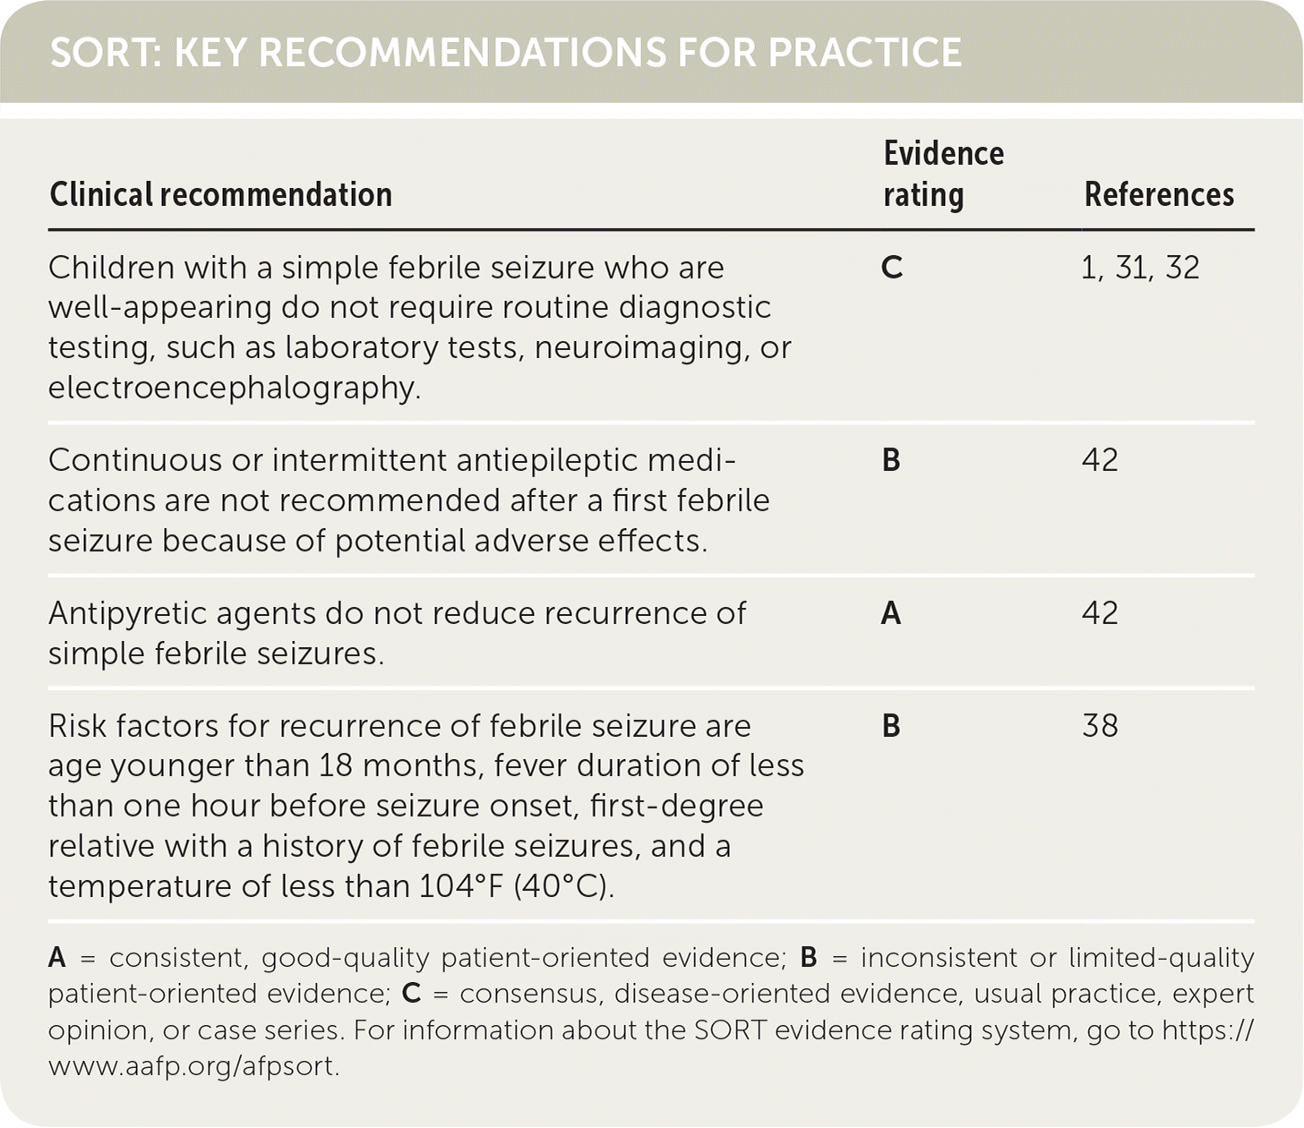
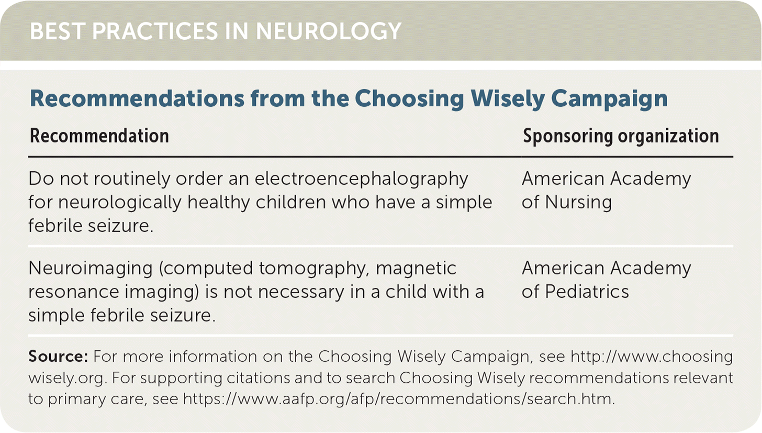
Management for simple febrile seizures
Notes:
Children who have a simple febrile seizure and are well-appearing do not require routine diagnostic testing (laboratory tests, neuroimaging, or electroencephalography), except as indicated to discern the cause of the fever

Slide 7
Management for complex febrile seizures
Decisions about diagnostic testing may not be as straightforward in children with a complex febrile seizure, because complex febrile seizures are more heterogeneous.
The neurologic examination is crucial when deciding whether to perform a lumbar puncture.
In a case series of 526 patients with a first complex febrile seizure, only four patients had clinically significant intracranial pathology, and three of those four had obvious findings on physical examination.
Neuroimaging is not necessary for complex febrile seizures unless the child has abnormal or focal findings on neurologic examination.
Electroencephalography (EEG) has no role in the acute management of febrile seizures and does not predict recurrence. However, outpatient EEG should be performed in children with multiple risk factors for epilepsy (developmental delay, family history of epilepsy, and more than one defining feature of a complex febrile seizure) because of the risk of subsequent nonfebrile seizures
Notes:
In patients with complex febrile seizures, the neurologic examination can help determine whether laboratory tests are indicated. Well-appearing children with complex febrile seizures have a low risk of hypoglycemia, and although they may have slightly lower serum sodium levels, those levels do not predict seizure recurrence.^{24,25} Persistently abnormal mental status between or after seizures should prompt evaluation for hypoglycemia and electrolyte abnormalities.
Children with signs and symptoms of bacterial meningitis should undergo lumbar puncture.
Febrile status epilepticus should raise suspicion for serious bacterial infection, intracranial abnormality, or toxic ingestion.
In a single series of 24 children with febrile status epilepticus, acute bacterial meningitis was diagnosed in four of the children; therefore, lumbar puncture should be performed in children with this condition.

Slide 8
Acute management
Prehospital and emergent management should focus on stabilizing the patient (ABCs [airway, breathing, and circulation])
Most febrile seizures are self-limited and end before patients arrive at the hospital. However, seizures lasting longer than five minutes are unlikely to stop on their own, and a benzodiazepine should be administered to break the seizure
A 2018 Cochrane review concluded that intravenous lorazepam (Ativan) and diazepam have similar rates of seizure cessation and respiratory depression
When intravenous access is unavailable, buccal midazolam or rectal diazepam (Diastat) is acceptable.
The Cochrane review concluded that there is insufficient evidence to support the use of intranasal benzodiazepines

Slide 9
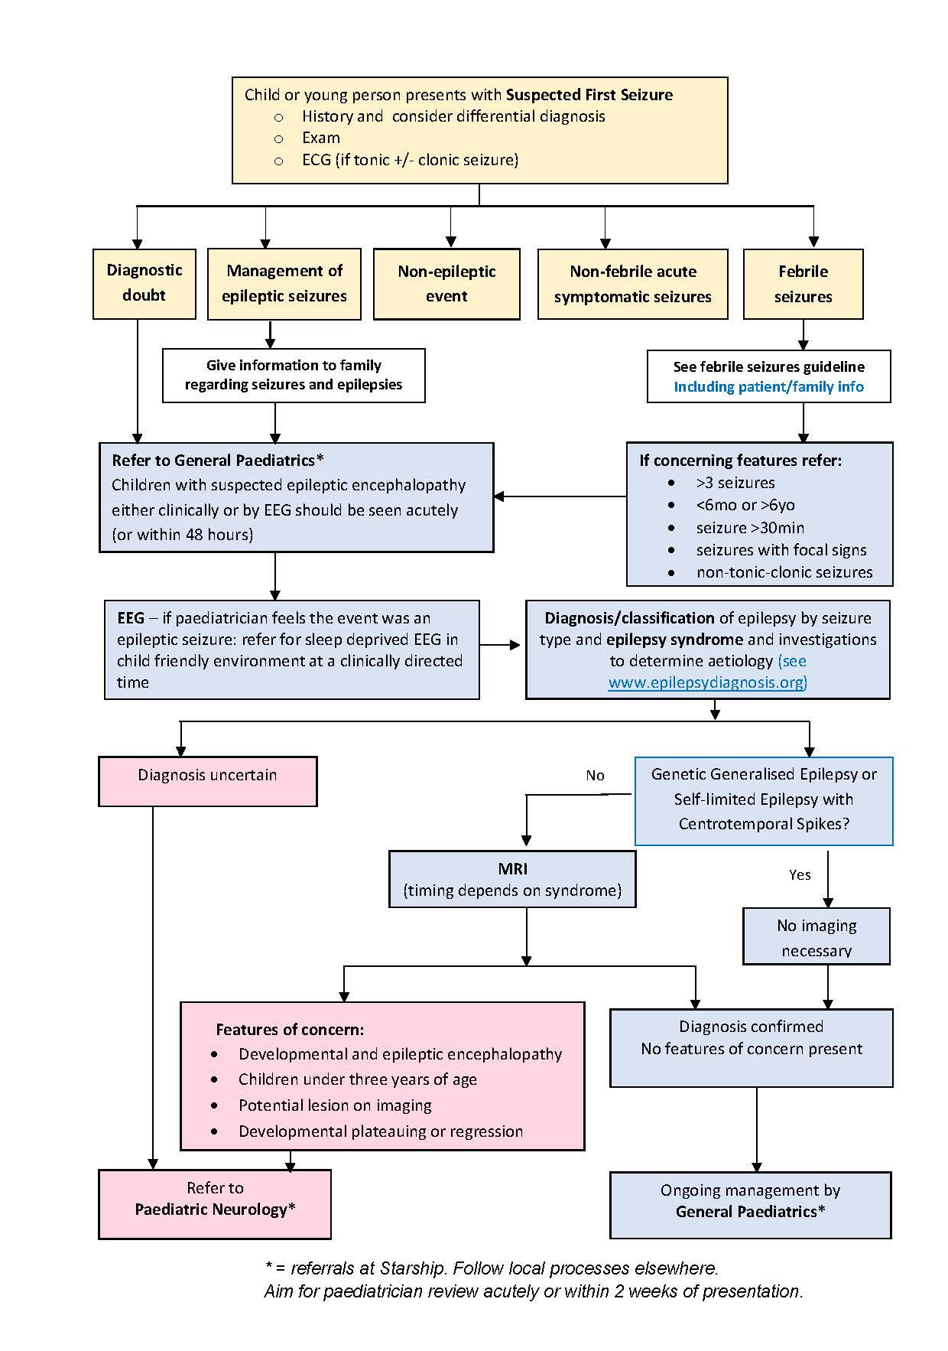
Seizures in children

Slide 10
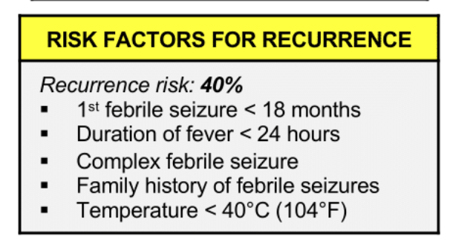
Questions parents may have:
Will they have one again? Will they get epilepsy? Will they have brain damage? Was this from a vaccine?
Epilepsy occurs more frequently in children who have had febrile seizures than in the general population. In a normal child with a simple febrile seizure, the risk is approximately 1 to 2 percent, only slightly above that of the general population . For children with complex febrile seizures, an abnormal developmental history, or a family history of epilepsy, the risk is closer to 5 to 10 percent.
Notes:
Neurologic sequelae, including new neurologic deficits, intellectual impairment, and behavioral disorder, are rare following febrile seizures.
The prognosis for children with febrile seizures is favorable. While early reports had suggested that febrile seizures were associated with an increased risk of sudden death, the results from a large population-based study indicate that the small excess in mortality among children with febrile seizures is restricted to those with complex febrile seizures [34]. Furthermore, the increased risk in those patients is explained, at least in part, by preexisting neurologic abnormalities and subsequent epilepsy.
Epilepsy occurs more frequently in children who have had febrile seizures than in the general population. In a normal child with a simple febrile seizure, the risk is approximately 1 to 2 percent, only slightly above that of the general population . For children with complex febrile seizures, an abnormal developmental history, or a family history of epilepsy, the risk is closer to 5 to 10 percent.
Certain vaccine preparations and associated age at administration have been shown to increase the risk of febrile seizures.⁹ The measles-mumps-rubella vaccine is associated with an increased risk of febrile seizures (10 additional cases per 10,000 children 16 to 23 months of age, but only four additional cases per 10,000 children 12 to 15 months of age).^{10,11} Because the increased risk of seizures with measles-containing vaccines is lower when administered at 12 to 15 months, the age recommended by the Centers for Disease Control and Prevention, it is important to provide timely immunizations to mitigate potential risks.^{11,12} There is also a slight increase in risk in the 24 hours following the administration of the measles-mumps-rubella-varicella vaccine compared with separate measles-mumps-rubella and varicella vaccines (3.5 additional cases per 10,000 children)

Slide 11
Resources
Smith DK, Sadler KP & Benedum M. Am Fam Physician. 2019 Apr 1; 99(7):445-450
Jensen KV & Liu N. Peds case notes: febrile seizures. Accessed at https://www.pedscases.com/febrile-seizures-0
Notes:
https://www.aafp.org/afp/2019/0401/p445.html

